Slide 1

SMART DOOR LOCK
RAMAKRISHNA REDDY ALAVALA
MURALI KRISHNA SAI CHUKKA

Slide 2
Motivation

Slide 3
Features
Unlock or Lock the door from any where.
One Time Pass Code.
Recorded message.
Took picture of the person while unlocking the door.
Face Recognition.

Slide 4
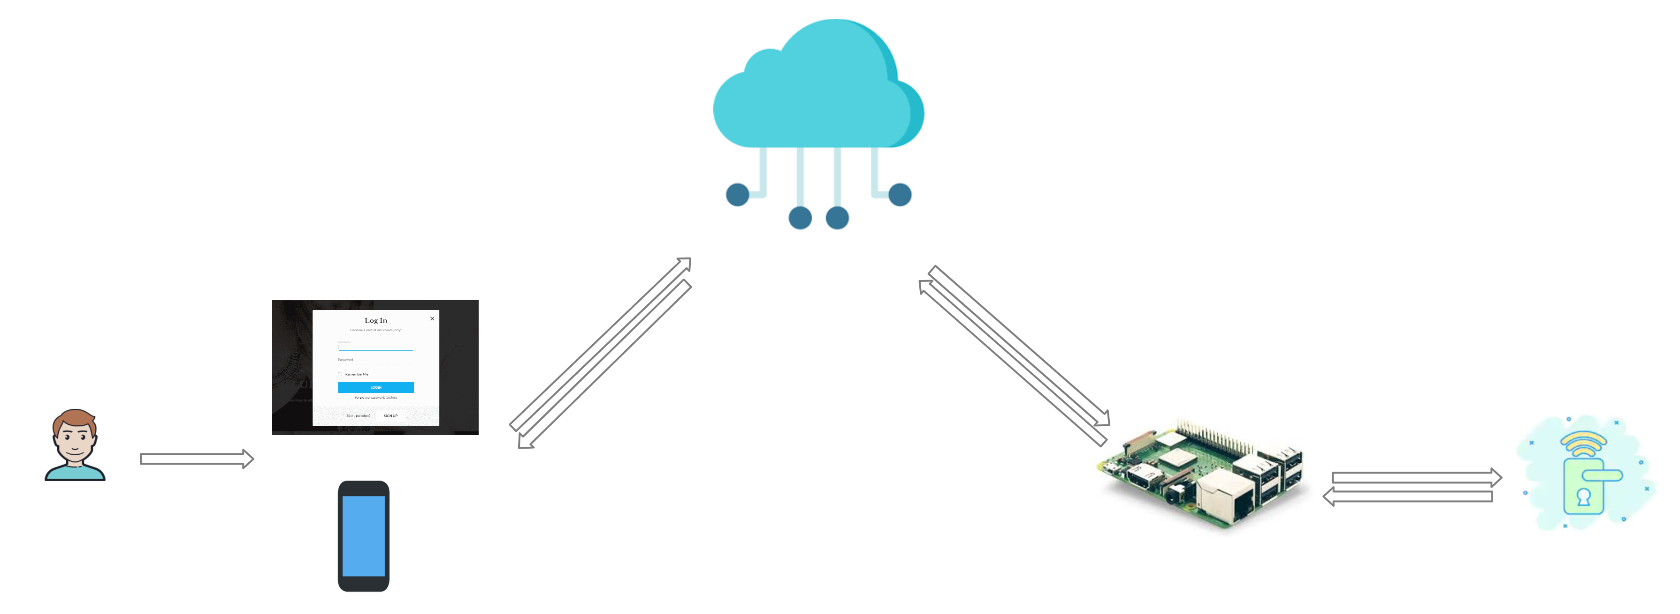
System Architecture

Slide 5
Modules
Web:
Login.
Apartment registration.
Face recognition.
One time pass code.
Profile.
Report.
IOT:
Home.
Access code entry.
Instructions.

Slide 6
Tech
Cloud:
Azure.
Full Stack:
MEAN stack.
IOT device:
Raspberry pi.
Servo Motor.

Slide 7
Questions ?

Slide 8
Thank you.

